Slide 1
TCRC GROUP
EMPOWERING BUISNESSES WITH QUALITY ASSESMENTS AND SURVEY SOLUTIONS.

Slide 2
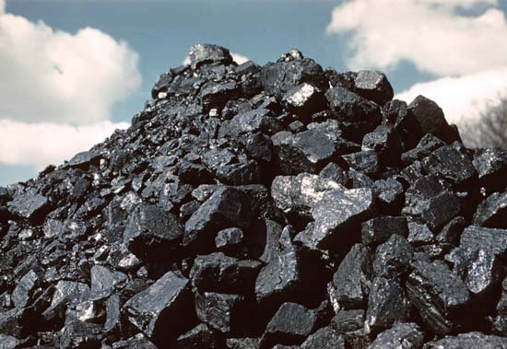
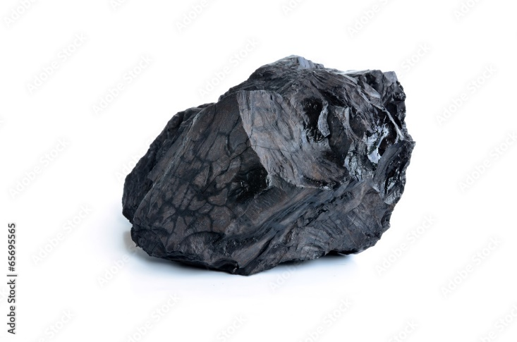
COAL
Definition and Formation:
Coal is a combustible black or brownish-black sedimentary rock formed from the remains of plants that lived millions of years ago. The formation process involves the accumulation of plant debris in swamps or marshes, which undergoes transformation due to heat and pressure over time.

Slide 3
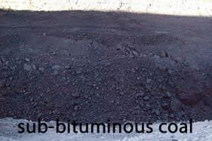
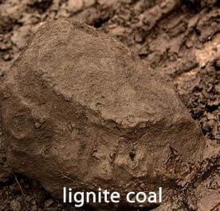
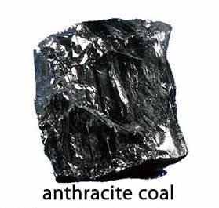
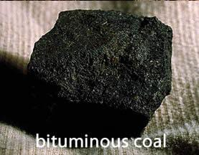
Types of Coal:
There are several types of coal, categorized based on their carbon content, energy content, and geological properties. The main types include:
1. Anthracite: The highest rank of coal, known for its high carbon content and low moisture and impurities. It is often referred to as "hard coal.
2. Bituminous: This type of coal is widely used for electricity generation and industrial processes. It has a moderate to high carbon content and is characterized by its shiny appearance.
3. Sub-bituminous: With a lower carbon content compared to bituminous coal, sub-bituminous coal is commonly used in power plants due to its relatively high energy content.
4. Lignite: Also known as "brown coal," lignite has the lowest carbon content among coal types and is characterized by its high moisture content and low energy density.

Slide 4
Geological Distribution:
Coal deposits are found in various parts of the world, with significant reserves located in regions such as the United States, China, India, Australia, and Russia. The geological distribution of coal depends on factors such as past vegetation, tectonic activity, and sedimentary processes.

Slide 5
Properties of Coal:
Physical Properties:
Color: Coal can range in color from black to brownish-black, depending on its composition and impurities.
Density: The density of coal varies depending on its type and composition, with denser coal generally having a higher carbon content.
Hardness: Coal hardness varies across different types, with anthracite being the hardest and lignite being relatively soft.
Chemical Composition:
Carbon Content: Coal primarily consists of carbon, with higher carbon content indicating a higher quality and energy density.
Sulfur Content: Coal may contain sulfur compounds, which can contribute to environmental pollution when burned. Low-sulfur coal is preferred for reducing emissions.
Other Elements: Coal also contains hydrogen, oxygen, nitrogen, and trace elements, which influence its combustion properties and environmental impact.
Energy Content:
The energy content of coal is determined by its carbon content and calorific value. Higher-rank coals like anthracite have a higher energy content, making them more suitable for energy production and industrial applications.

Slide 6
UTILITY OF COAL
Electricity Generation: Coal is extensively used for electricity generation worldwide. Coal-fired power plants burn coal to produce steam, which drives turbines connected to generators, generating electricity. The abundance of coal reserves and its relatively low cost have historically made it a preferred choice for baseload electricity generation, providing a stable and consistent supply of power to meet the demands of homes, businesses, and industries.
Industrial Processes like Steel and Cement Production: Coal plays a crucial role in the production of steel and cement. In the steel industry, coal is used as a primary raw material in the form of coke, which is produced by heating coal in the absence of air to drive off volatile compounds. Coke is then used in blast furnaces to reduce iron ore into molten iron, a key step in steelmaking. In cement production, coal is used as a fuel in kilns to heat and calcine raw materials such as limestone, clay, and shale, ultimately producing cement clinker.
Heating and Cooking: Coal has been historically used for heating and cooking purposes in residential, commercial, and industrial settings. While its use for these purposes has declined in many developed countries due to environmental and health concerns, coal remains an essential source of heat in regions where alternative energy sources may be limited or costly.
Transportation, Particularly in Steel and Iron Industries: Coal is utilized in transportation, especially in industries like steel and iron production. It's used in the form of coke to fuel blast furnaces, which produce molten iron for steelmaking. Additionally, coal is utilized in the transportation sector indirectly through the production of steel and iron for manufacturing vehicles, rails, and infrastructure.
Chemical Production for Plastics and Fertilizers: Coal serves as a feedstock for the production of various chemicals used in manufacturing plastics, fertilizers, and other industrial products. Through processes like coal gasification and coal-to-chemicals, coal can be converted into synthesis gas (syngas) or other intermediates, which are then used as building blocks for producing a wide range of chemicals and materials.
Providing Reliable Backup and Baseload Power: Coal-fired power plants are capable of providing reliable backup and baseload power, meaning they can operate continuously at high capacity to meet the minimum electricity demand. This reliability makes coal a valuable resource for maintaining grid stability and ensuring a consistent power supply, particularly during periods of high demand or when renewable energy sources are unavailable or intermittent.
Creating Jobs and Fostering Economic Development: The coal industry has historically been a significant source of employment and economic development in regions with abundant coal reserves. Coal mining, transportation, and related industries support jobs in various sectors, including mining operations, equipment manufacturing, transportation logistics, and ancillary services. Additionally, coal revenues contribute to local economies through taxes, royalties, and investments in infrastructure and community development projects.

Slide 7
Environmental Impact:
Air Pollution:
Coal combustion releases various pollutants into the atmosphere, contributing to air pollution. Greenhouse gas emissions, such as carbon dioxide (CO2), methane (CH4), and nitrous oxide (N2O), contribute to climate change by trapping heat in the atmosphere. Additionally, coal-fired power plants emit sulfur dioxide (SO2) and nitrogen oxides (NOx), which can lead to acid rain, smog formation, and respiratory problems. Particulate matter (PM), including fine particles and ash, can also be released during combustion, posing health risks and affecting air quality.
Water Pollution:
Coal mining and processing activities can contaminate water sources through various mechanisms. Surface mining operations can disrupt natural drainage patterns, leading to the release of pollutants into nearby water bodies. Additionally, runoff from coal storage facilities and waste disposal sites can carry pollutants such as heavy metals, sediment, and toxic chemicals into rivers, streams, and groundwater. Coal-fired power plants also generate wastewater containing pollutants like heavy metals, chlorides, and sulfates, which can contaminate surface and groundwater if not properly managed.
Land Degradation:
Coal mining operations can cause significant land degradation and habitat destruction. Surface mining techniques, including mountaintop removal and strip mining, can result in the removal of vegetation, topsoil, and geological layers, altering landscapes and ecosystems. These activities can disrupt wildlife habitats, reduce biodiversity, and lead to soil erosion and sedimentation in nearby water bodies. In addition, coal ash disposal sites and abandoned mine sites can pose long-term risks to land quality and ecosystem health if not adequately reclaimed and remediated.

Slide 8
Future of Coal:
Trends in Coal Consumption:
The future of coal consumption is influenced by various factors, including economic growth, energy demand, technological advancements, and environmental concerns. While coal has historically been a dominant source of energy for electricity generation and industrial processes, its share in the global energy mix is expected to decline over time. This trend is driven by several factors, including the increasing competitiveness of renewable energy sources such as solar and wind power, the declining cost of natural gas, and efforts to mitigate climate change by reducing greenhouse gas emissions.
In many developed countries, coal consumption has already begun to decline due to the retirement of aging coal-fired power plants, stricter environmental regulations, and the growing adoption of cleaner energy technologies. However, coal continues to play a significant role in the energy portfolios of some countries, particularly in regions with abundant coal reserves and limited access to alternative energy sources.
In contrast, coal consumption is projected to continue growing in developing countries, particularly in Asia, where rapid industrialization and urbanization are driving demand for affordable and reliable energy. However, concerns about air pollution, water scarcity, and climate change are leading many countries to explore cleaner and more sustainable alternatives to coal.

Slide 9
Environmental Regulations and Compliance:
Environmental regulations and policies play a crucial role in shaping the future of coal by influencing its production, consumption, and environmental impact. Governments around the world are increasingly implementing stricter emissions standards, pollution controls, and carbon pricing mechanisms to reduce the environmental footprint of coal-based activities and encourage the transition to cleaner energy sources.
Key regulatory initiatives include limits on greenhouse gas emissions, air pollutant emissions standards, water quality regulations, and requirements for environmental impact assessments and remediation measures. Compliance with these regulations requires coal producers, power plant operators, and other stakeholders to invest in pollution control technologies, fuel switching, and renewable energy integration to minimize environmental risks and ensure regulatory compliance.

Slide 10
Coal analysis standard
Coal analysis standards are crucial for ensuring consistent and accurate evaluation of coal properties. Some of the widely recognized standards organizations that provide guidelines for coal analysis include:
1. American Society for Testing and Materials (ASTM): ASTM has several standards related to coal analysis, covering aspects such as proximate analysis, ultimate analysis, calorific value determination, ash fusion temperatures, and sulfur content determination. ASTM D3172 and ASTM D3174 are examples of standards for proximate and ultimate analysis, respectively.
2. International Organization for Standardization (ISO): ISO develops international standards for various industries, including coal analysis. ISO 11722 provides guidelines for proximate analysis of coal, ISO 11760 covers determination of ash content, and ISO 7404-5 outlines methods for sulfur determination.
3. British Standards Institution (BSI): BSI publishes standards relevant to coal analysis. For example, BS ISO 11722:2013 specifies a method for the determination of the moisture content of a lot of coal.
4. European Committee for Standardization (CEN): CEN sets standards for various industries within Europe. EN 15407 is an example of a CEN standard for the determination of total sulfur in coal.
5. International Energy Agency (IEA): While not a standards organization per se, the IEA provides guidelines and recommendations for coal analysis through its publications and initiatives aimed at promoting best practices in the energy sector.
It's essential to refer to the specific standards relevant to the parameters being analyzed to ensure accurate and consistent results.

Slide 11
PARAMETERS | MEANING OR DEFINATION | OUR ANALYSIS STANDARD
TOTAL MOISTURE | The total moisture content in coal includes both inherent moisture (water held within the coal itself) and surface moisture (water on the surface of the coal particles). It's expressed as a percentage of the mass of the coal sample. (Also used to calculate GCV (ARB) value.
INHERANT MOISTURE | Inherent moisture refers to the moisture present within the coal matrix itself. It's determined by drying the coal sample in a controlled environment and measuring the loss in weight. (Also used to calculate GCV (ARB) value.
VOLATILE MATTER | Volatile matter represents the combustible gases and vapors driven off from coal during heating in a limited supply of air or oxygen. It's an important parameter affecting the combustion characteristics of coal and is expressed as a percentage of the mass of the coal sample. ( it is also used to calculate fixed carbon value)
ASH | Ash content refers to the incombustible residue left after coal combustion. It includes minerals, silica, and other impurities present in the coal. Ash content is determined by burning the coal sample and measuring the residue left behind, expressed as a percentage. ( it is also used to calculate fixed carbon value)
FIXED CARBON | Fixed carbon is the portion of coal that remains after volatile matter and moisture have been driven off. It represents the solid carbonaceous material available for combustion and is calculated by subtracting the moisture, volatile matter, and ash content from 100%.

Slide 12
GROSS CALORIFIC VALUE | Gross calorific value, also known as higher heating value, is the amount of heat released by burning a unit mass of coal completely, including the latent heat of vaporization of water formed during combustion. It's typically measured in joules per kilogram (J/kg) or British thermal units per pound (BTU/lb).
NET CALORIFIC VALUE | Net calorific value, also known as lower heating value, is the gross calorific value minus the heat of vaporization of water formed during combustion. It represents the useful heat available from burning coal and is typically lower than the gross calorific value.
SULPHUR | Sulfur content in coal refers to the amount of sulfur present in the coal matrix. High sulfur content can lead to environmental pollution and corrosion issues during combustion. It's usually expressed as a percentage of the mass of the coal sample. ( if coal contains more than 1% sulphur than it is harmful for the environment)
PHOSPHOROUS | Phosphorus content in coal indicates the presence of phosphorus compounds, which can affect combustion behavior and emissions. It's typically expressed as a percentage of the mass of the coal sample.
CSN | The Crucible Swelling Index is a measure of the plasticity and swelling behavior of coal when heated in a standardized crucible under controlled conditions. It indicates the coal's propensity to swell, soften, and form a plastic mass, which is important for the formation of a cohesive coke structure during carbonization.
HGI | HGI is a measure of the grindability of coal, indicating the ease with which coal can be pulverized. It's determined by grinding a coal sample in a standardized mill and measuring the grindability index.

Slide 13
ULTIMATE ANALYSIS | Ultimate analysis provides the elemental composition of coal, including carbon, hydrogen, nitrogen, sulfur, and oxygen, typically expressed as a percentage of the mass of the coal sample.
ASH FUSION TEMPERATURE | Ash fusion temperature refers to the temperature at which coal ash softens and fuses into a molten mass. It's an important parameter for predicting slagging and fouling tendencies in boilers and furnaces.
1. IDT | IDT is the temperature at which coal ash begins to soften and deform.
2. ST | ST is the temperature at which coal ash softens further and begins to form a molten slag.
3.HT | HT is the temperature at which the coal ash forms a hemispherical shape during heating.
4.FT | FT is the temperature at which the coal ash flows freely.
ASH ANALYSIS | Ash analysis involves determining the chemical composition of coal ash, including the concentration of various minerals and elements.
HEAVY METALS | Heavy metals in coal ash, such as mercury, lead, arsenic, and cadmium, can have environmental and health impacts if released into the air or water during combustion.
CSR | CSR and CRI are measures of the strength and reactivity of coke produced from coal, respectively. They are important parameters for assessing the suitability of coal for metallurgical processes.
CRI
M10 | M10 and M40 are measures of the mechanical strength of coke. M10 represents the coke's abrasion resistance, while M40 represents its strength after reacting with carbon dioxide.
M40

